Slide 1
DOLIGHT OPTOELECTRONICS TECHNOLOGY CO., LTD
Just do light, Just Dolight

Slide 2
Company Profile
Dolight was founded in 2008. DOLIGHT started LED business with bulbs and spot light in SHENZHEN. Since 2013, DW brand was founded and began to design, develop and manufacture the highest quality professional LED panel light. With the expansion of LED panels business，in May 2015 DOLIGHT factory move to Huizhou city considering to enlarge our factory scale.
Our company has 2 factories with different brands. One is LED panels for Europe high professional market with DW brand. The other is LED tube for Russia, India, Turkey low cost market.The whole companies has around 130 employees.
The panel production area is 2500sqm totally with workers around 60 employees. Our production capacity is around 30K pcs monthly. We have developed Frameles panel, narrow frame panel, UGR panels, IP65 panel... Various series of panel light has offered our customers flexibility when facing different need from market.
The main characteristic feature of DOLIGHT is the balanced relationship between innovative technology, fashionable design, reliable quality and competitive price.
Now our products are warmly welcomed and sold by Europe, South America and Southeast Asia market.
Our goal for 2017-2018 is to enlarge our panel sales to 50K monthly 2 auto production lines coming into use.
On of the strategy is to establish the partnership with our powerful customer， hand in hand, to develop new products and capture market share.

Slide 3
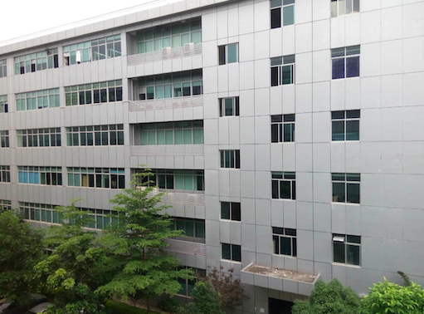
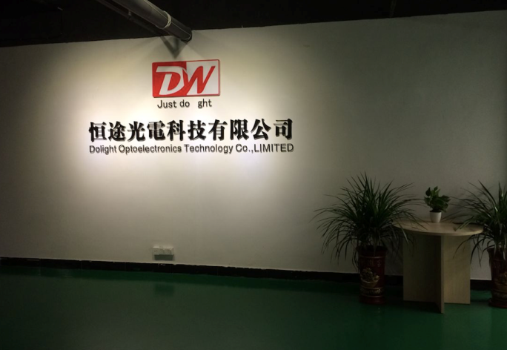
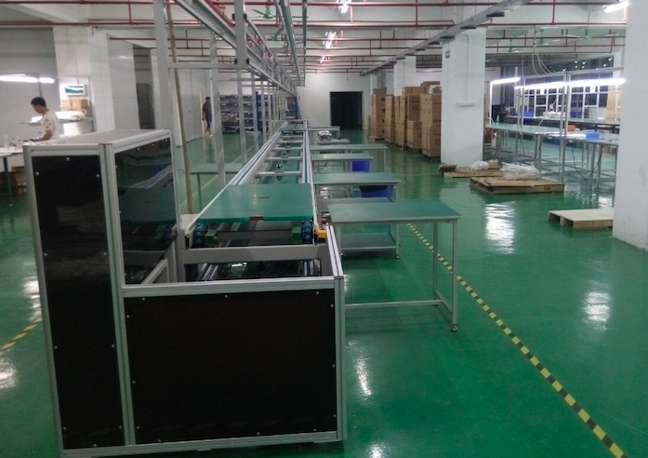
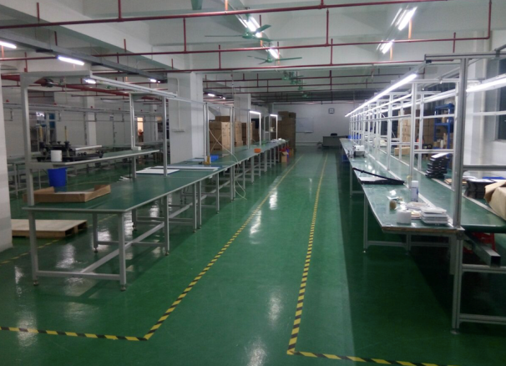
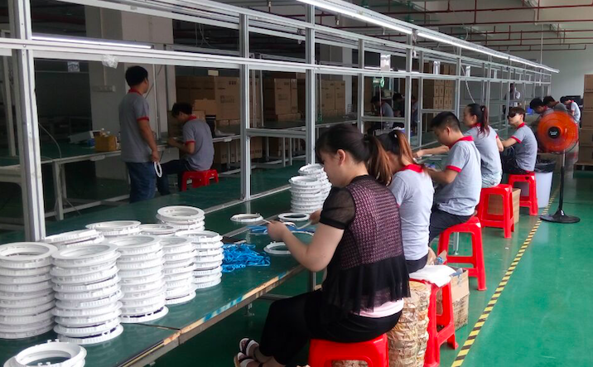
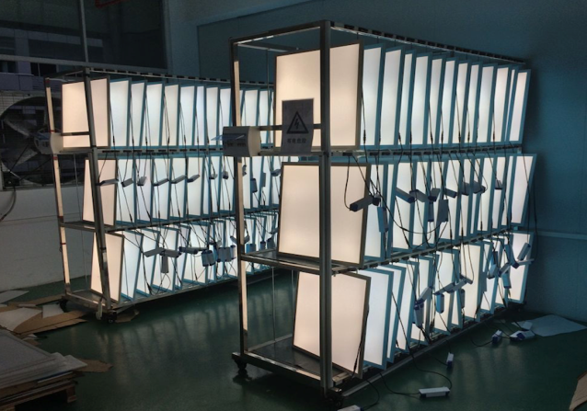
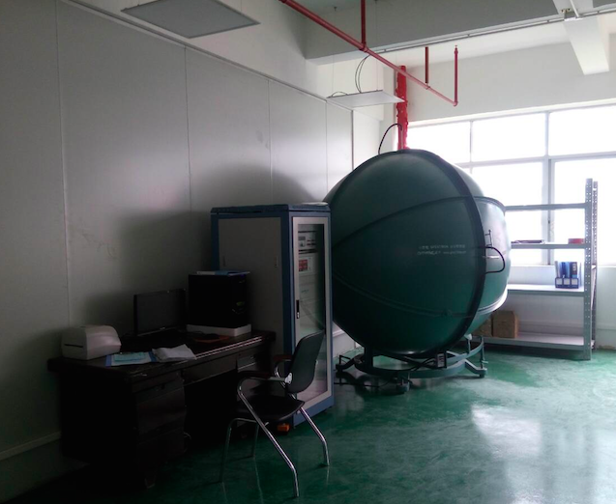
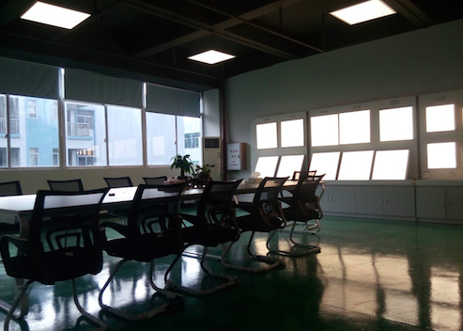
Factory Tour

Slide 4
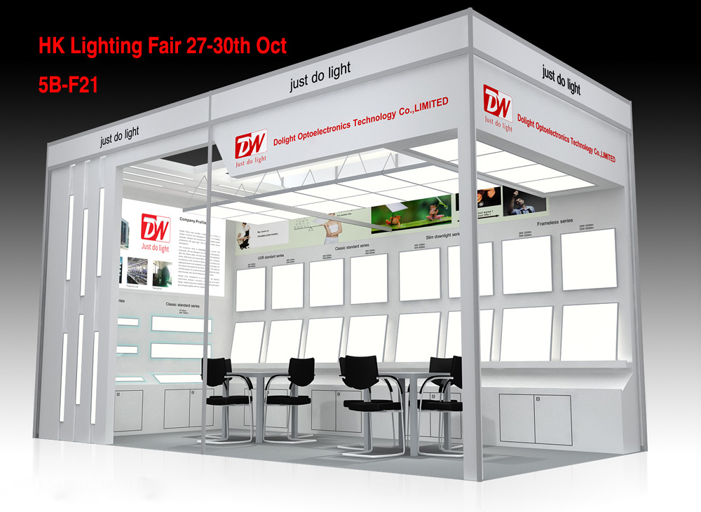
Fair
Frankfurt Lighting fair
HK Lighting fair
GZ Lighting fair
Poland lighting fair

Slide 5
Product Tree
Focus on LED Panel Light
Different size and functions panel for choose

Slide 6
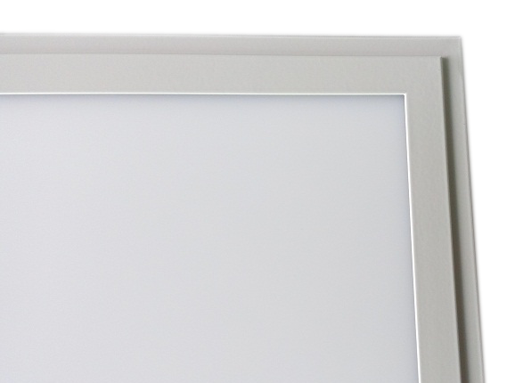
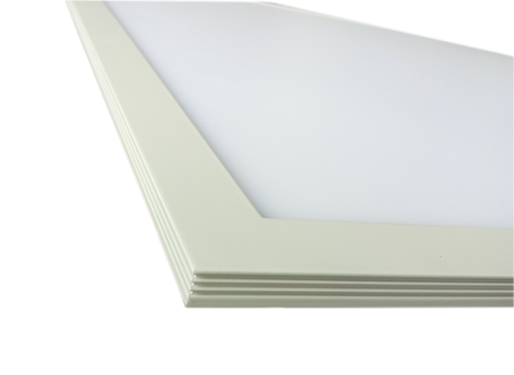
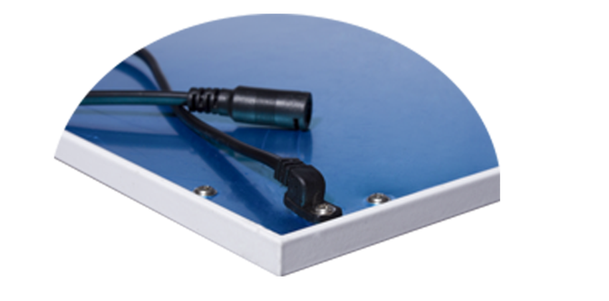
Classic Series
Series | Lumen Efficiency | Power | Size
Classic Project | 130LM/W | 26W/36W | 595x595mm 620x620mm 295x1195mm
Classic Bright | 120LM/W | 26W/36W
Classic Pro | 100LM/W | 18W/36W/48W | 295x295mm 595x595mm 620x620mm 295x1195mm 595*1195mm
Classic Standard | 85LM/W | 18W/36W/48W

Slide 7
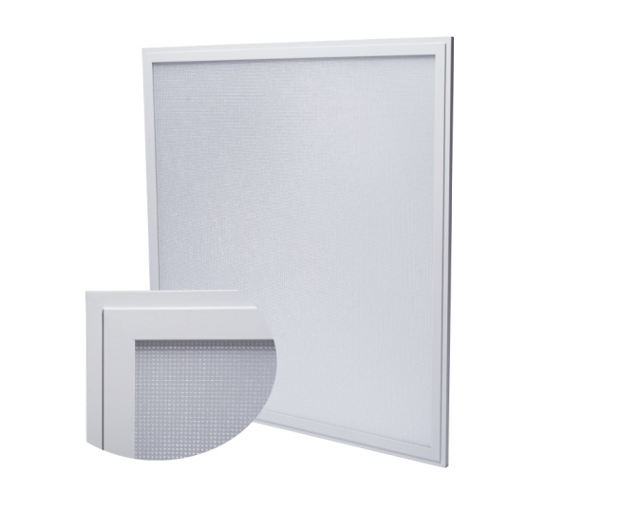
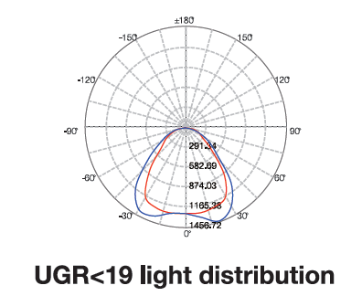
UGR<19 Series
Series | Lumen Efficiency | Power | Size
UGR<19 Project | 130LM/W | 26W/36W | 595x595mm 620x620mm 295x1195mm
UGR<19 Bright | 120LM/W | 26W/36W
UGR<19 Pro | 100LM/W | 18W/36W/48W | 295x295mm 595x595mm 620x620mm 295x1195mm 595*1195mm
UGR<19 Standard | 85LM/W | 18W/36W/48W

Slide 8
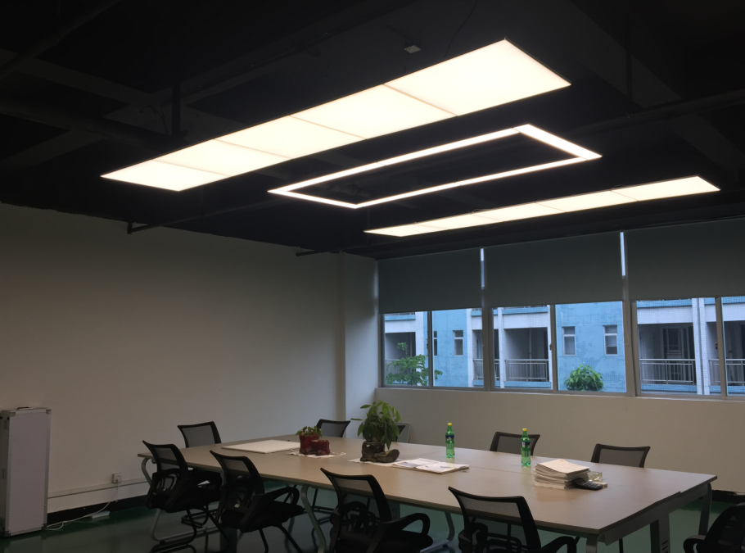
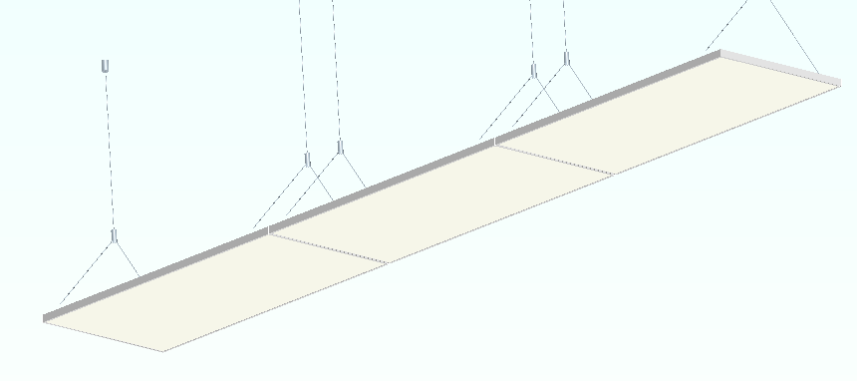
Narrow Frame Series--4mm
Series | Lumen Efficiency | Power | Size
Standard Narrow Frame | 100LM/W | 36W/48W | 295x295x14mm 595x595x14mm 620x620x14mm

Slide 9
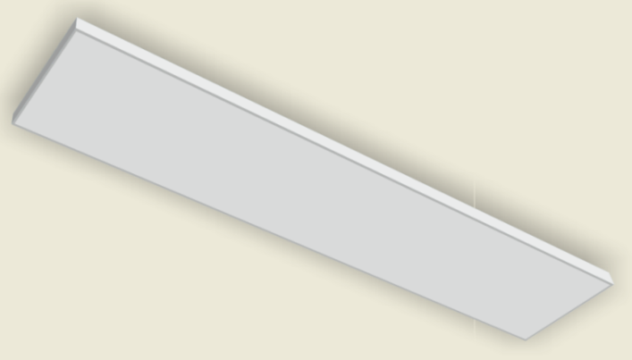
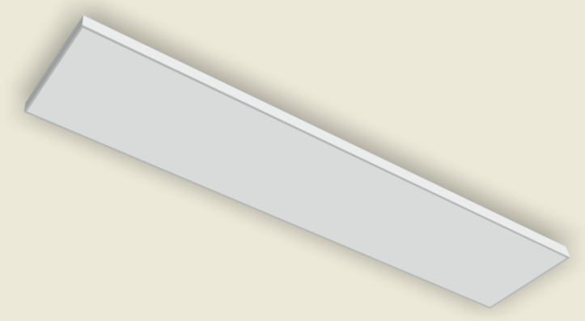
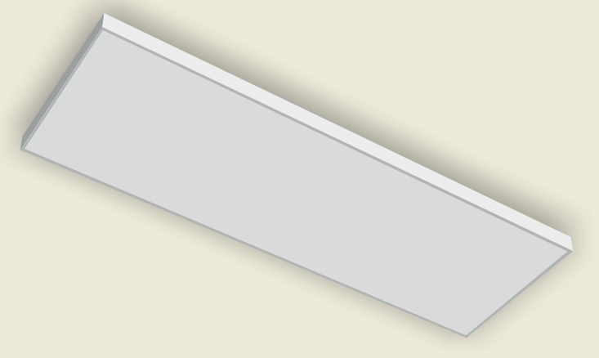
Linear narrow frame
Size | Power | Efficiency
100&595*14mm 100&1000*14mm 100&1195*14mm | 18w 24w 30w | 90lm/w
195&595*14mm 195&1000*14mm 195&1195*14mm | 18w 36w 36w | 90-100lm/w
295&595*14mm 295&1000*14mm 295&1195*14mm | 18w 36w 36w | 90-100lm/w
145x1195x14mm | 30W | 85LM/W

Slide 10
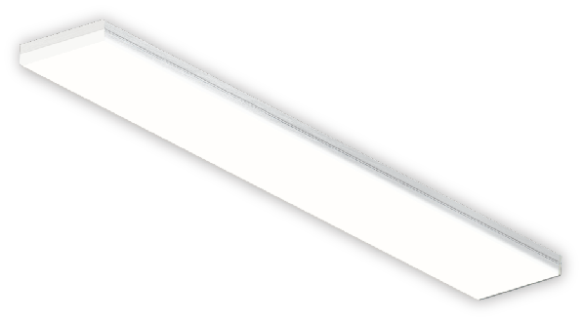
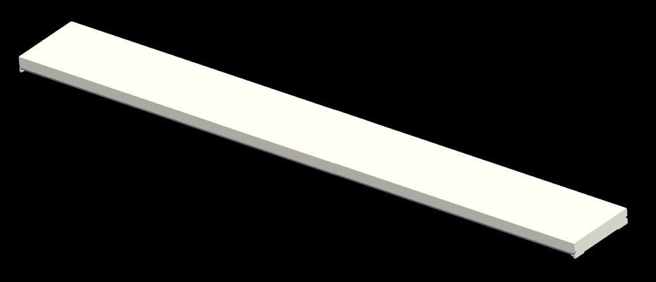
Linear Framless
Size | Power | Efficiency
145*595*30mm | 36w | 80-90lm/w
145*1195*30mm | 36w/48w | 100-110lm/w
145*1495*30mm | 48w/60w | 100-110lm/w

Slide 11
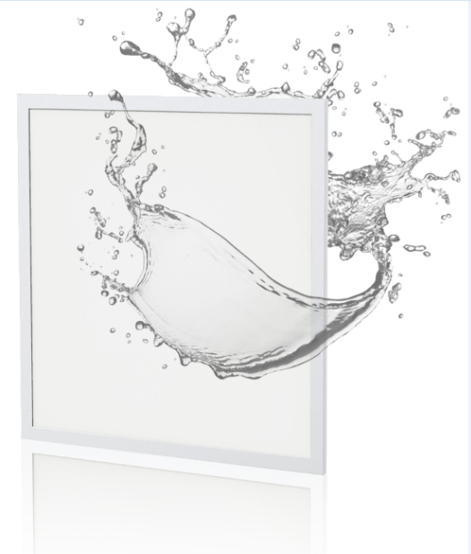
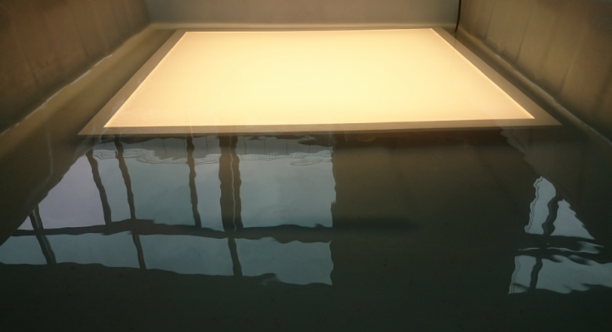
IP65 Series-IP65 & IP54
Series | Lumen Efficiency | Power | Size
IP65 | 100LM/W | 18W/36W/48W | 295x295mm 595x595mm 620x620mm 295x1195mm
IP54 | 100LM/W | 18W/36W/48W

Slide 12
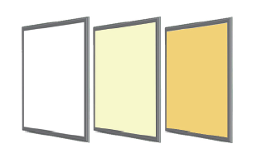
CCT Tunable-3000K-6000K
Series | Lumen Efficiency | Power | Size
CCT Tunable | 85LM/W | 32W/48W | 295x295mm 595x595mm 620x620mm 295x1195mm
1-10V Control
Remote Control
WIFI Control

Slide 13
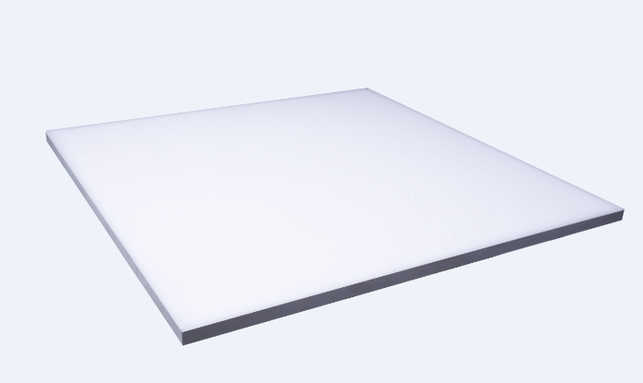
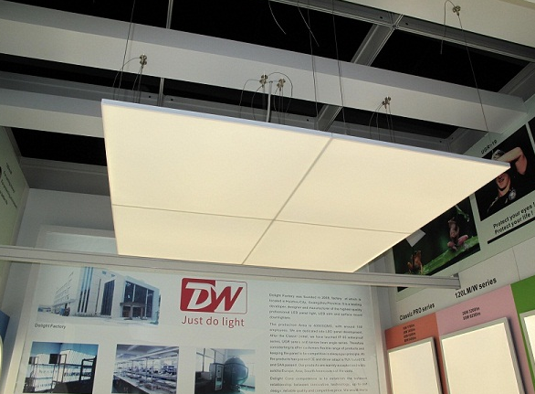
Frameless Series
Series | Lumen Efficiency | Power | Size
Framless | 90LM/W | 18W/36W/48W | 295x295mm 595x595mm 620x620mm 295x1195mm

Slide 14
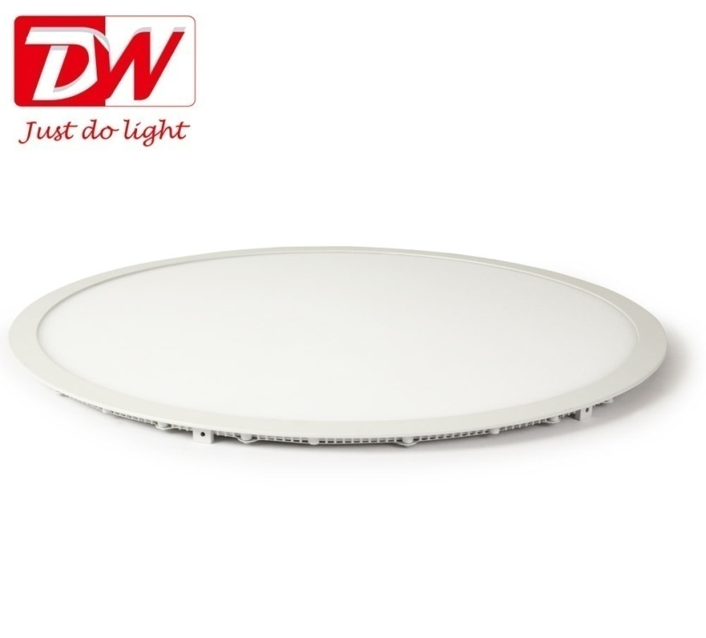
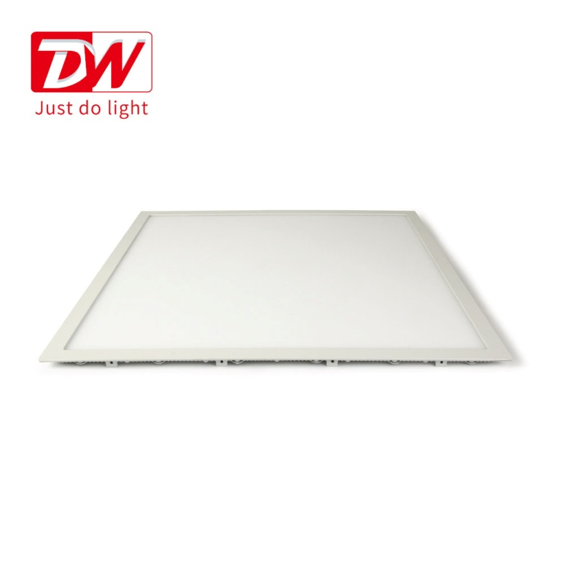
Slim Downlight Series
Series | Lumen Efficiency | Power | Size
Slim Downlight (Round & Square) | 70-85LM/W | 3W/6W/9W/12W/15W/18W/24W/36W/48W | 85mm/120mm/145mm/173mm/200mm/225mm/300mm/600mm

Slide 15
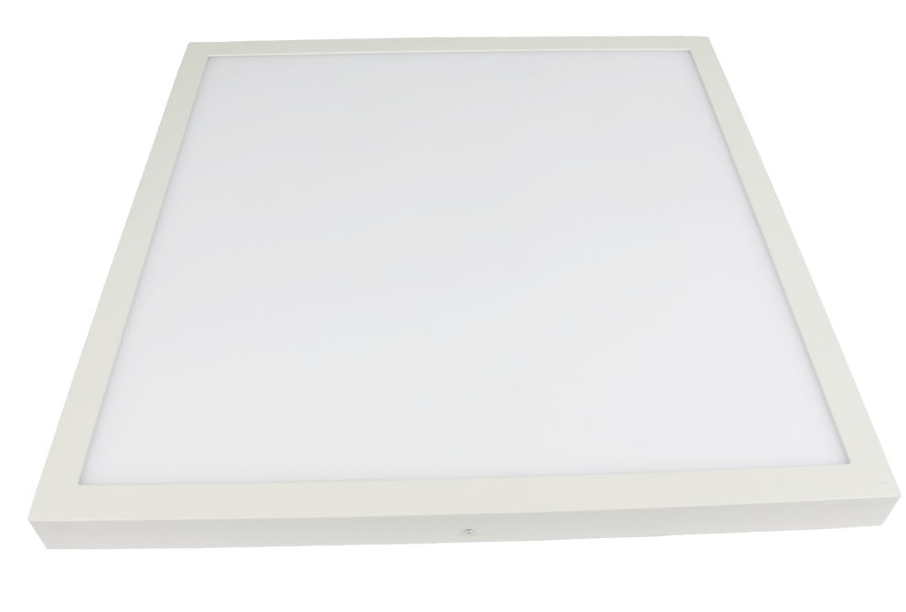
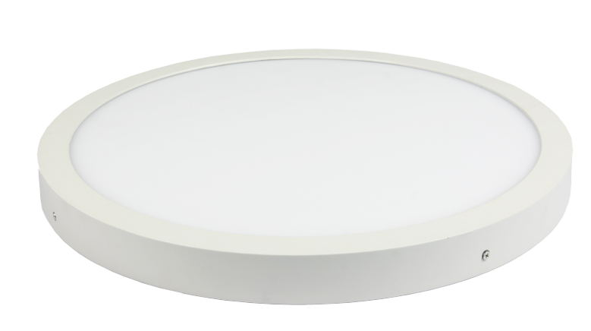
Surface Mount Downlight Series
Series | Lumen Efficiency | Power | Size
Surface Mount Downlight (Round & Square) | 70-85LM/W | 6W/12W/18W/24W/36W/48W | 120mm/174mm/225mm/300mm/600mm

Slide 16
Contact US
Tel: 0086-752-5312 830 Mob: 0086-13928316373
Email: super.do@dolight-led.com
Web: www.dolight-led.com

Slide 17
THANKS

